Slide 1

Inference on Two Groups - Two Sample or Paired Test

Slide 2
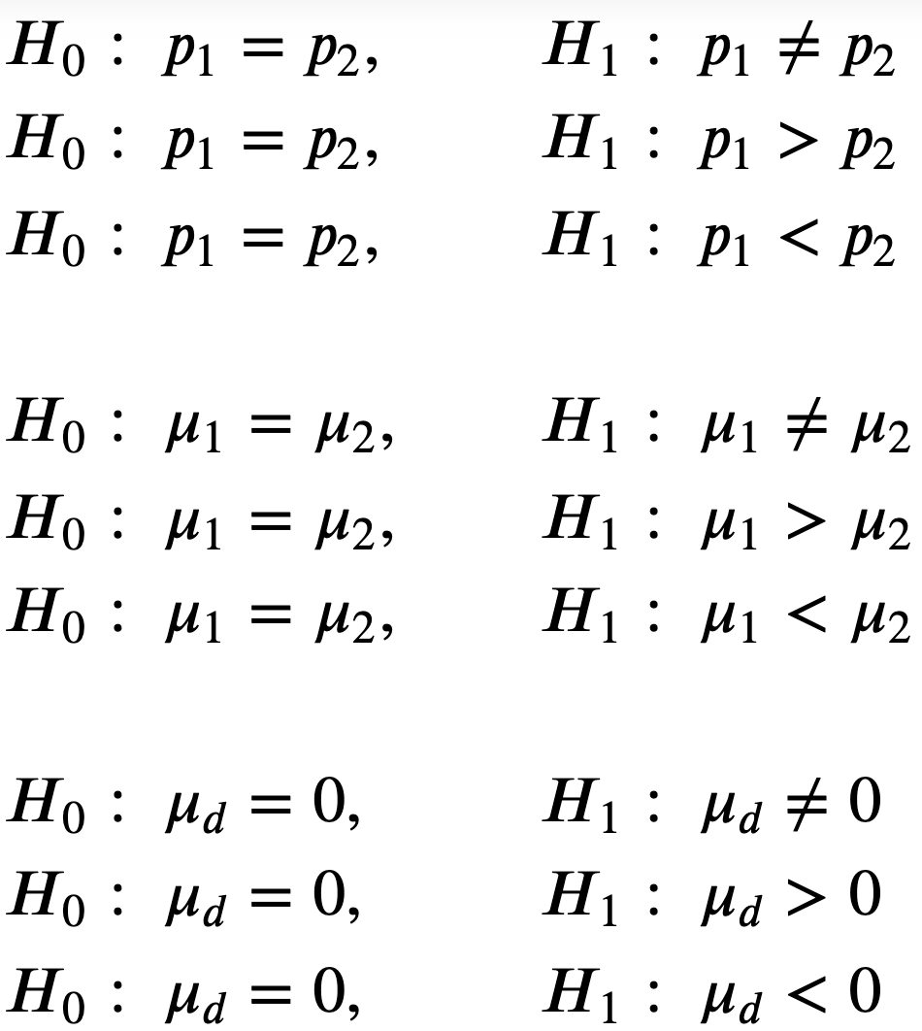
Two-sample test
Paired test

Slide 3
Two-sample test

Slide 4

Distribution

Slide 5
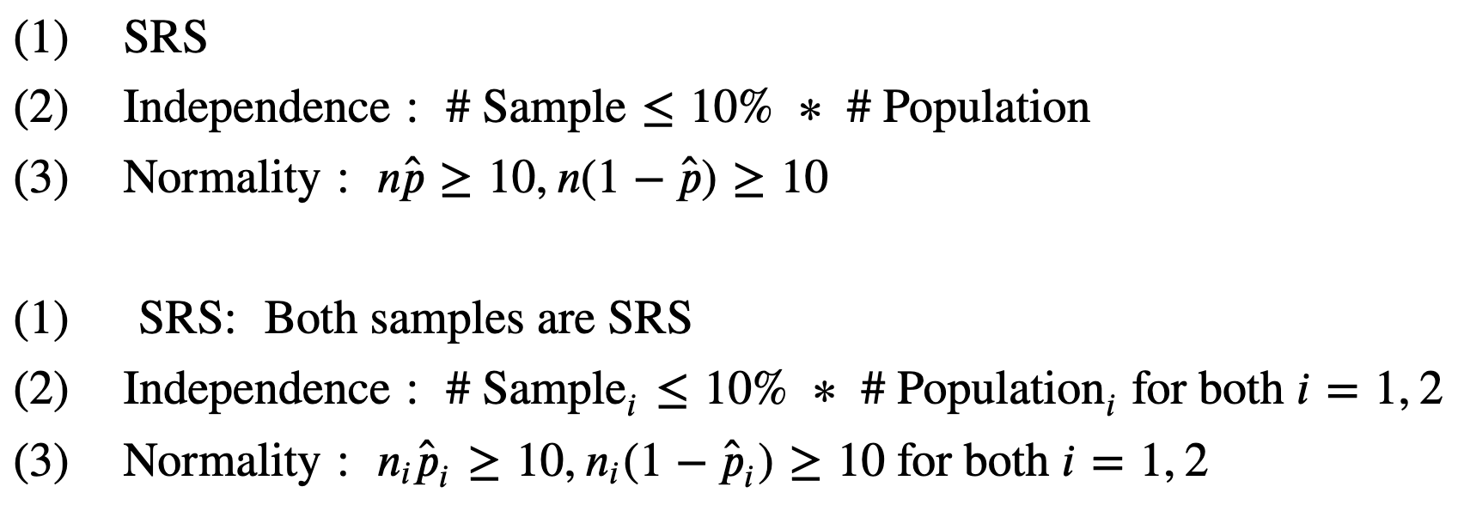
Conditions for Inference

Slide 6

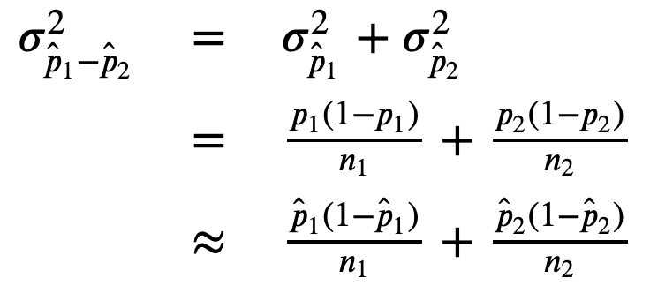

Slide 7
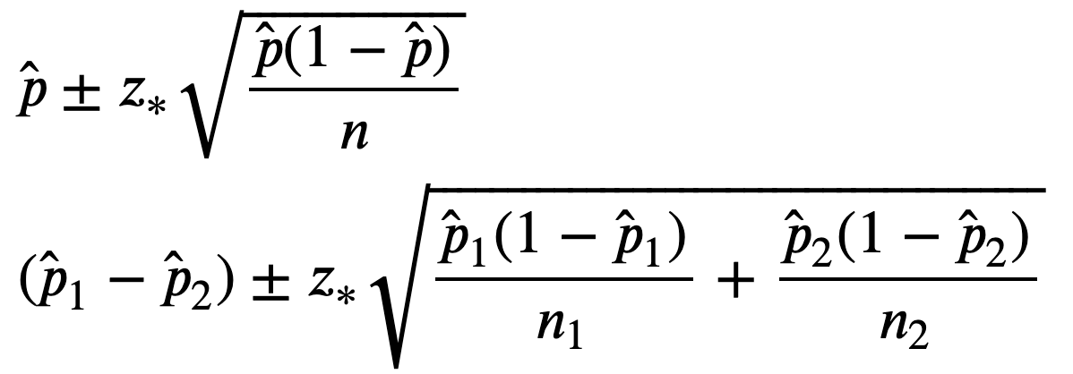
Confidence Interval

Slide 8
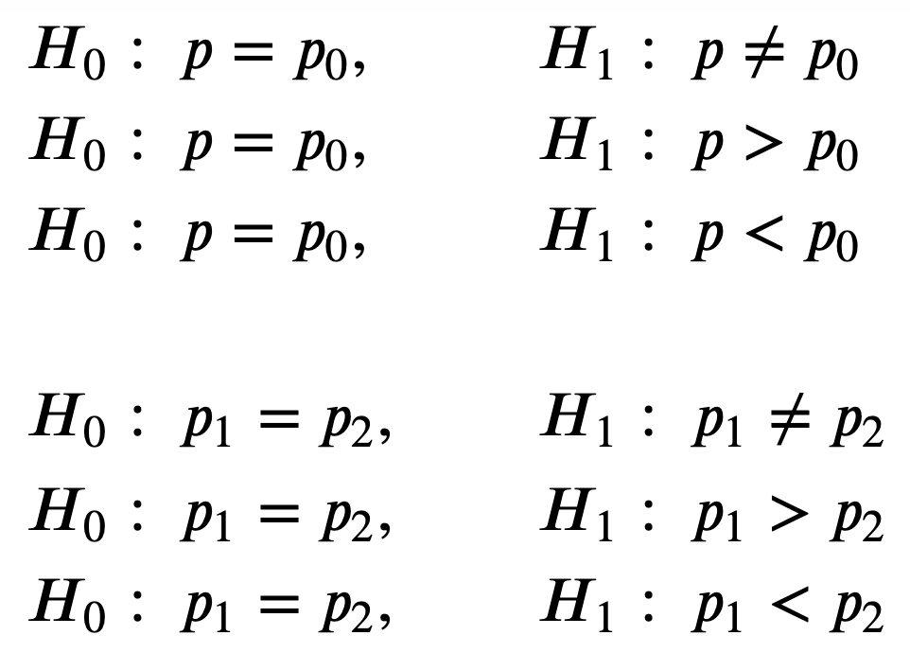
Testing

Slide 9

Distribution

Slide 10

Conditions for Inference

Slide 11

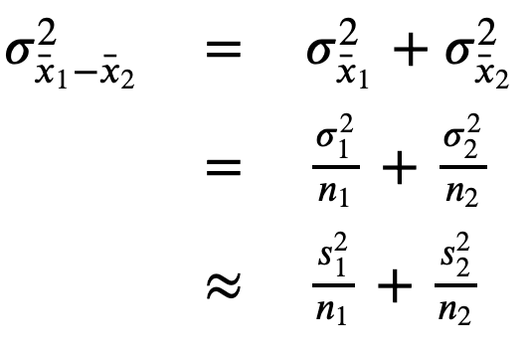

Slide 12
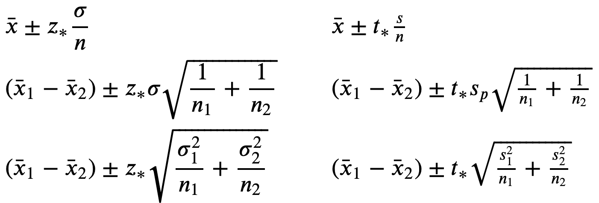
Confidence Interval

Slide 13
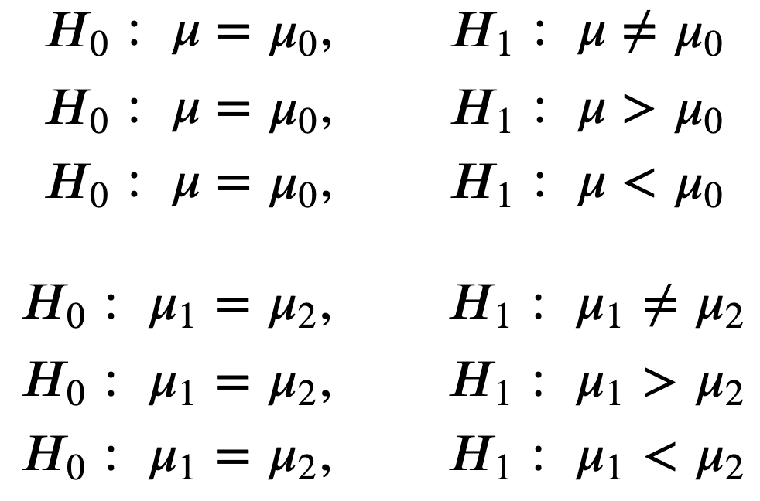
Testing

Slide 14
Paired test

Slide 15

Distribution

Slide 16
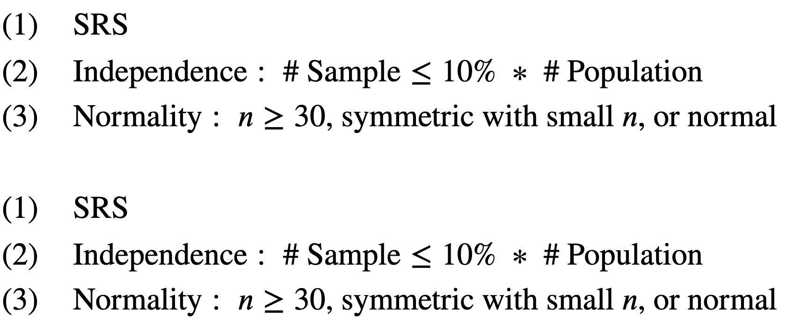
Conditions for Inference

Slide 17

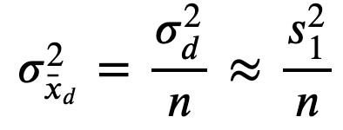

Slide 18
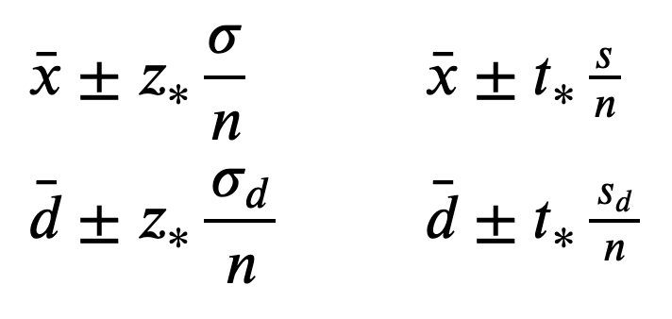
Confidence Interval

Slide 19
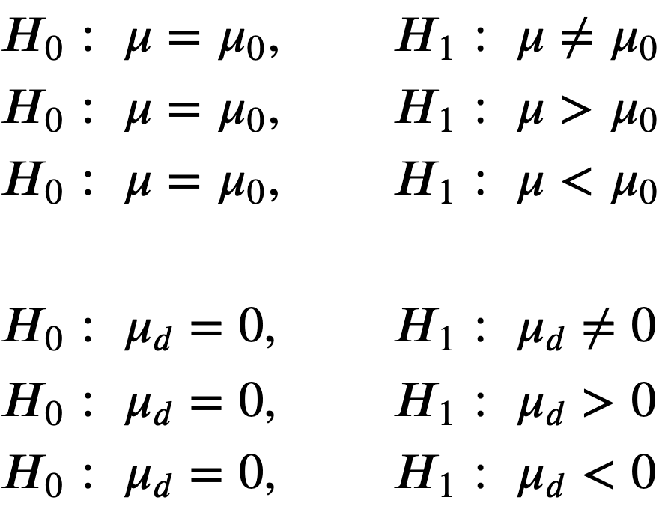
Testing

